Slide 1
Chain-Of-Thought Prompting
Presented at 36th Conference on Neural Information Processing Systems (NeurIPS 2022).

Slide 2
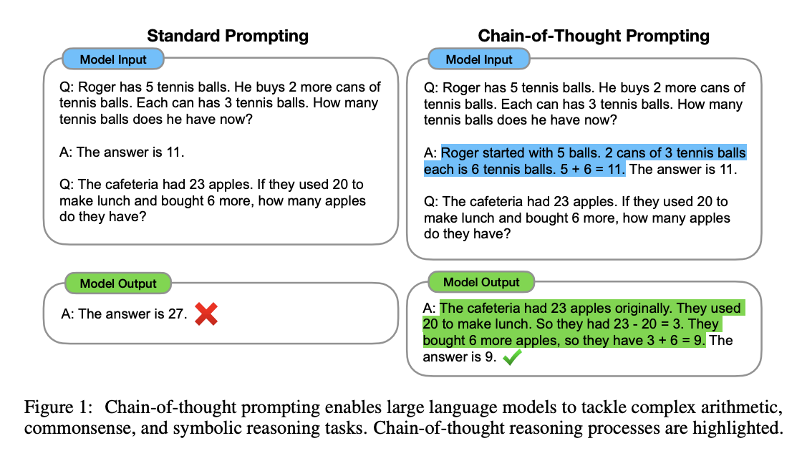
What is chain-of-thought Prompting
Chain of Thought(C-o-T): Method for breaking down complex problems into simpler, manageable steps.
Crucial for enhancing performance in arithmetic, common sense, and symbolic reasoning.
Example: PaLM 540B model, using 8 C-o-T exemplars, demonstrates superior performance over fine-tuned GPT-3.
Sets a new state-of-the-art performance in the GSM8K benchmark of math word problems.

Slide 3
Chain-Of-Thought Prompting
Concept and Application: Enables language models to generate coherent series of intermediate reasoning steps leading to the final answer.
Advantages:
Problem Decomposition: Allows models to tackle multi-step problems effectively by breaking them down.
Interpretability and Debugging: Provides an insight into how the model arrives at answers, aiding in error analysis.
Task Versatility: Applicable to a range of tasks including math word problems, commonsense reasoning, and symbolic manipulation.
Accessibility in Large Models: Can be elicited in large, off-the-shelf language models via few-shot prompting with examples.

Slide 4
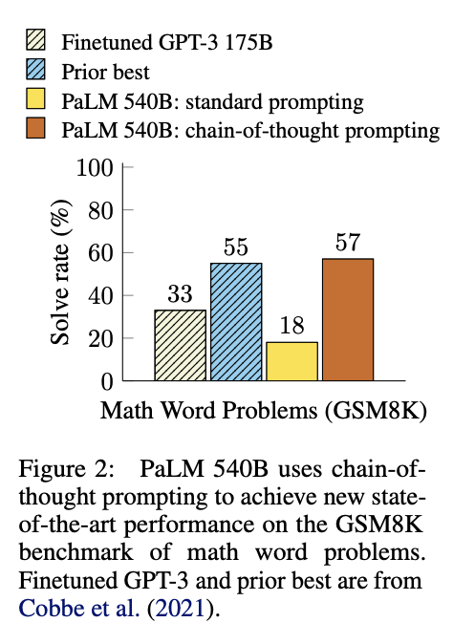
Chain-Of-Thought Prompting
Natural Language Problem-Solving: Demonstrates how C-o-T converts complex tasks into a series of logical steps.
Example of C-o-T in Action:
Problem: “Jane has 12 flowers. After giving 2 to her mom, and 3 to her dad, how many does she have left?”
C-o-T: “Jane gives 2 flowers to her mom, she has 10... then after she gives 3 to her dad, she will have 7... so the answer is 7.”
Benefits in Diverse Reasoning Tasks: Proven effectiveness in arithmetic, commonsense, and symbolic reasoning.
Interpretability: Provides a window into model's thought process, enhancing transparency.

Slide 5
Arithmetic Reasoning - Setup
Though simple for humans, arithmetic reasoning is a task where language models often struggle
Benchmark Overviews: GSM8K, SVAMP, ASDiv, AQuA, and MAWPS benchmarks.
Prompting Methods Compared: Standard few-shot prompting vs. chain-of-thought prompting.
Methodology of Study: Using few-shot exemplars with chains of thought for model prompting.

Slide 6
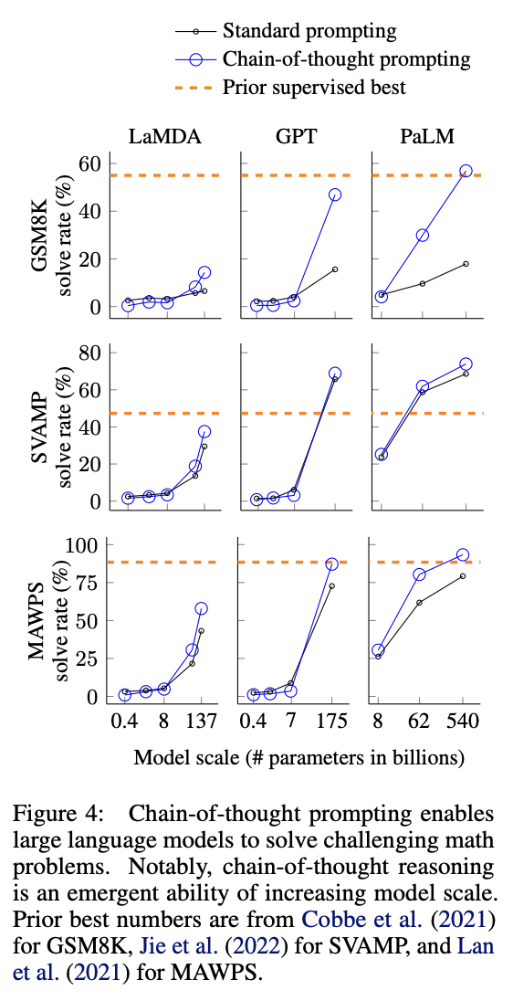
Arithmetic Reasoning - Results
Performance Leap with PaLM 540B: PaLM 540B model significantly outperforms standard models in arithmetic reasoning tasks.
Benchmark Comparisons: Clear superiority of C-o-T prompting evident across various math word problem benchmarks including GSM8K, SVAMP, ASDiv, AQuA, and MAWPS.
State-of-the-Art Achievement: Chain-of-thought prompting sets new performance records, especially notable in the GSM8K benchmark.
Model Size and Performance: Notably, the benefits of C-o-T prompting become pronounced with larger models (around 100B parameters).

Slide 7
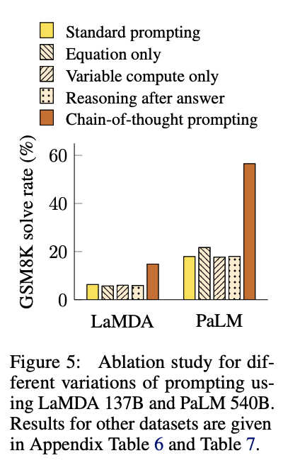
Arithmetic Reasoning - Ablation Study
Variation Testing: Analyzed the impact of different prompting methods on arithmetic reasoning.
Equation-Only vs. Full C-o-T: Just providing equations is less effective, especially for complex problems.
Computation Amount Not Key: More computation (using dots) doesn't enhance performance, underscoring C-o-T's unique contribution.
Sequential Reasoning Crucial: Placing C-o-T after the answer doesn't improve results, highlighting the need for sequential reasoning steps.

Slide 8
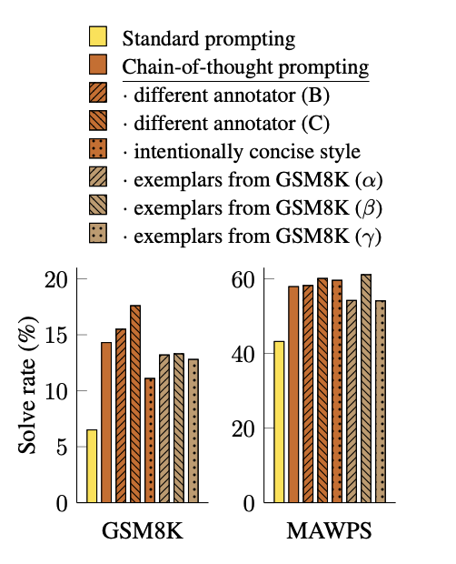
Robustness of Chain of Thought
Impact of Different Exemplars: Explored how changes in exemplars affect C-o-T performance.
Annotator Influence: Assessed how different annotators' interpretations impact the model's reasoning ability.
Consistency Across Scenarios: Demonstrated C-o-T's effectiveness remains robust under various conditions.

Slide 9
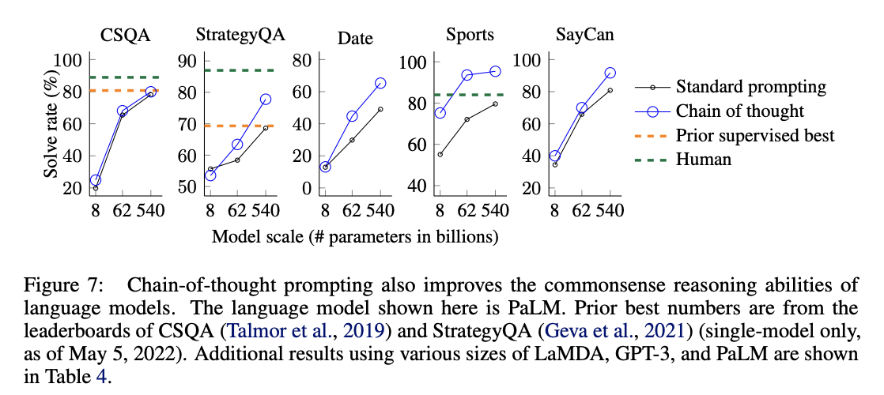
Common Sense Reasoning
C-o-T Enhances Commonsense Tasks: Showcases significant improvement in models' ability to reason in common sense scenarios.
Notable Performance Gains: Details how C-o-T outperforms standard approaches in nuanced, context-rich problems.
Real-World Examples: Provides specific instances where C-o-T improved outcomes in commonsense reasoning.

Slide 10
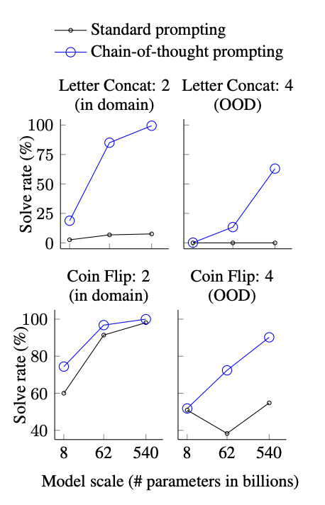
Symbolic Reasoning
Effective in Symbolic Tasks: Highlights C-o-T's success in interpreting and solving symbolic reasoning problems.
Complex Input Handling: Emphasizes C-o-T’s capability to process and analyze intricate symbolic data.
Case Study Examples: Shares specific examples from the paper demonstrating C-o-T’s impact.

Slide 11
Discussions
Study Insights: Summarizes major observations and learnings from the research.
AI Development Impact: Discusses how these findings can shape the future of language model development.
Exploring Potential and Limits: Reflects on the broad applications and any identified limitations of C-o-T.
Future Research Suggestions: Proposes directions for further investigation based on study outcomes.

Slide 12
Conclusion
Key Findings: Chain-of-thought (C-o-T) prompting significantly enhances reasoning abilities in large language models.
Effective with Large Models: Most effective with larger models (e.g., PaLM 540B), especially for complex, multi-step problems.
Beyond Simple Equations: C-o-T outperforms simple equation-only prompting, especially in semantically complex tasks.
Facilitates Natural Language Reasoning: Enables models to reason through problems step-by-step in natural language.
Broader Implications: These insights open up new possibilities for AI in complex problem-solving and reasoning tasks.

Slide 13
FAQs
FAQ 1: What is the role of prompt engineering?
Answer: Prompt sensitivity is crucial. Different prompts affect models in varied ways. C-o-T is robust to different annotators and exemplar variations, but prompt engineering can still significantly enhance performance.
FAQ 2: Will C-o-T prompting improve performance for my task?
Answer: C-o-T is broadly applicable, especially beneficial when tasks require multi-step reasoning, use large models, and when the scaling curve is relatively flat​​.
FAQ 3: Why is prompting with the equation only not enough?
Answer: While useful for simpler tasks, equation-only prompting falls short in complex scenarios like GSM8K, where the semantic challenge requires natural language reasoning steps​

Slide 14
Thank You.

